Slide 1


Cenz
Date: 17/12/2021

Slide 2
01. My Name
02. My Experience
03. My Life
04. Connect Me
3
4
12
13

Slide 3

01.
My Name
Cent
Cenz

Slide 4

02.
My Experience

Slide 5















My Timeline
2021 Dec
2019 Sep
2019 Jul
Now
2019 May
2015
2018 Aug

Slide 6
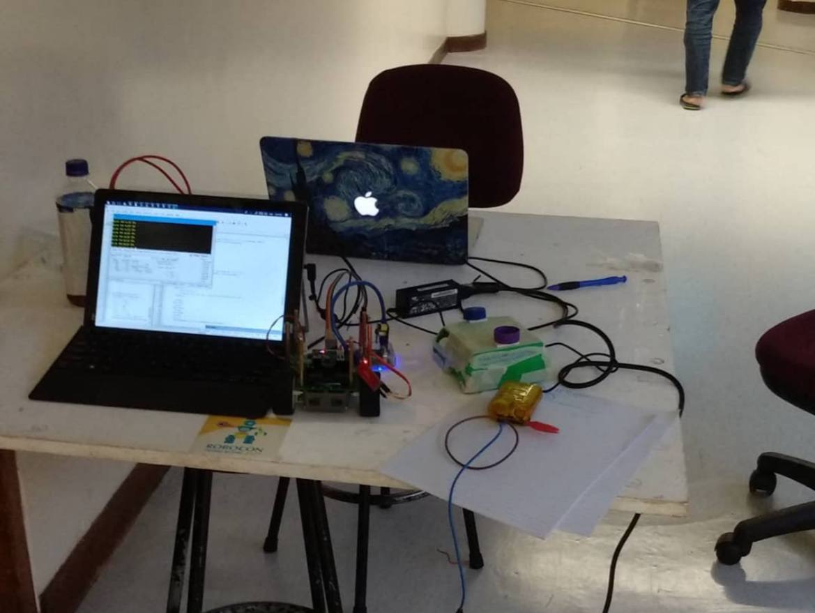
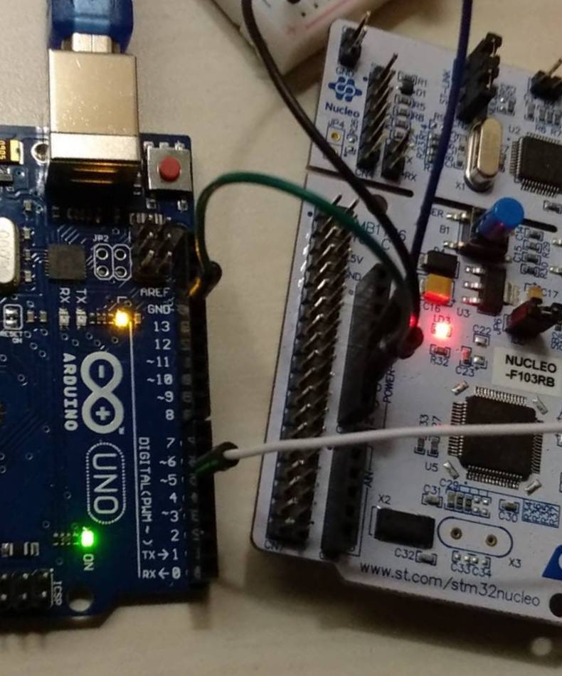
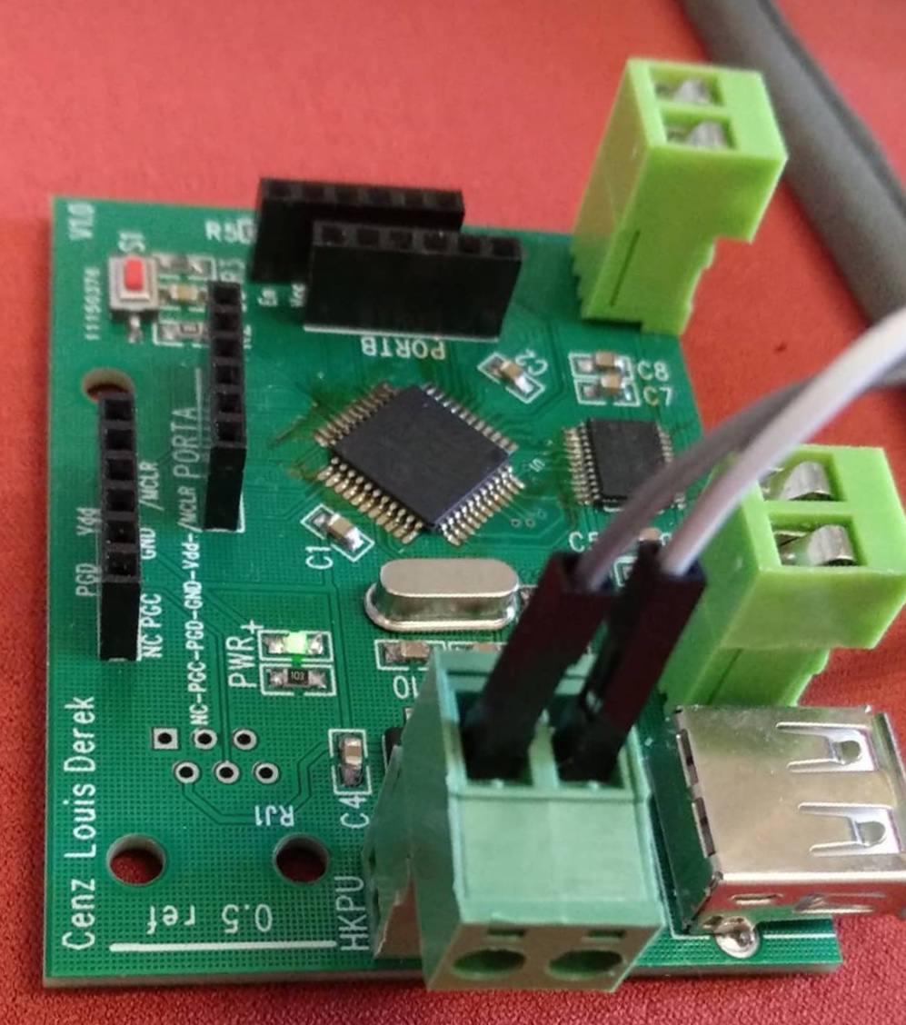
PolyU EIE

Slide 7

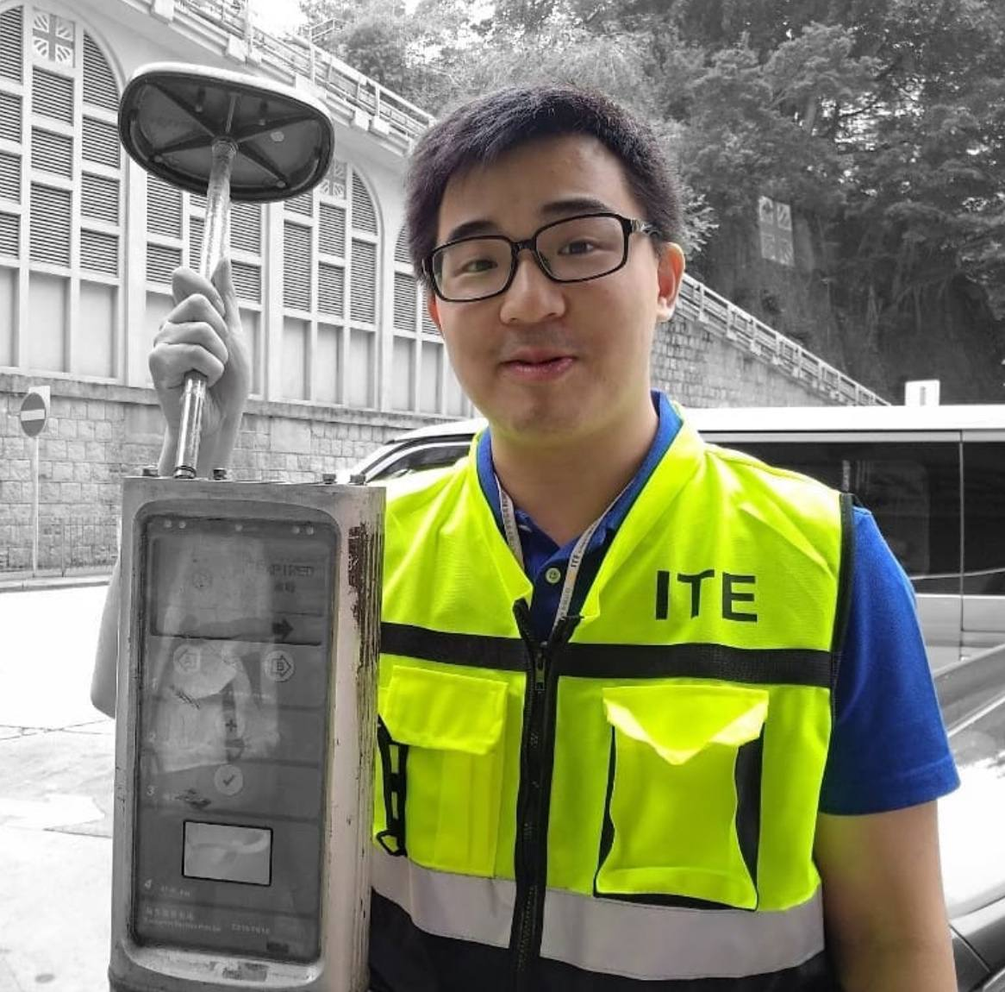
Gap Year Internship

Slide 8
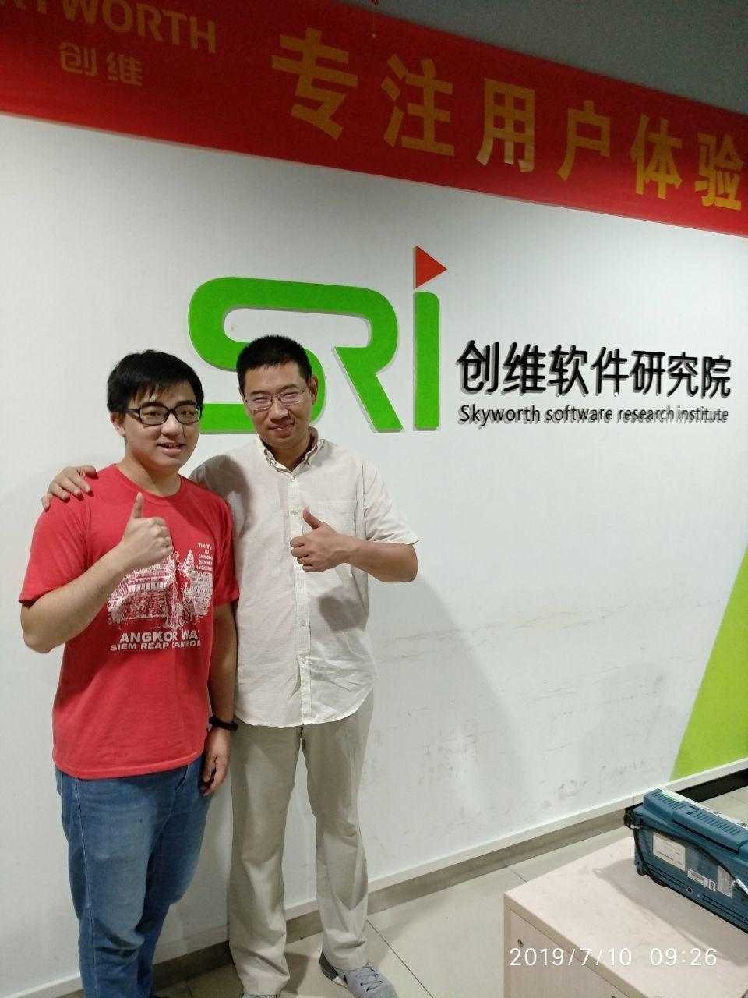
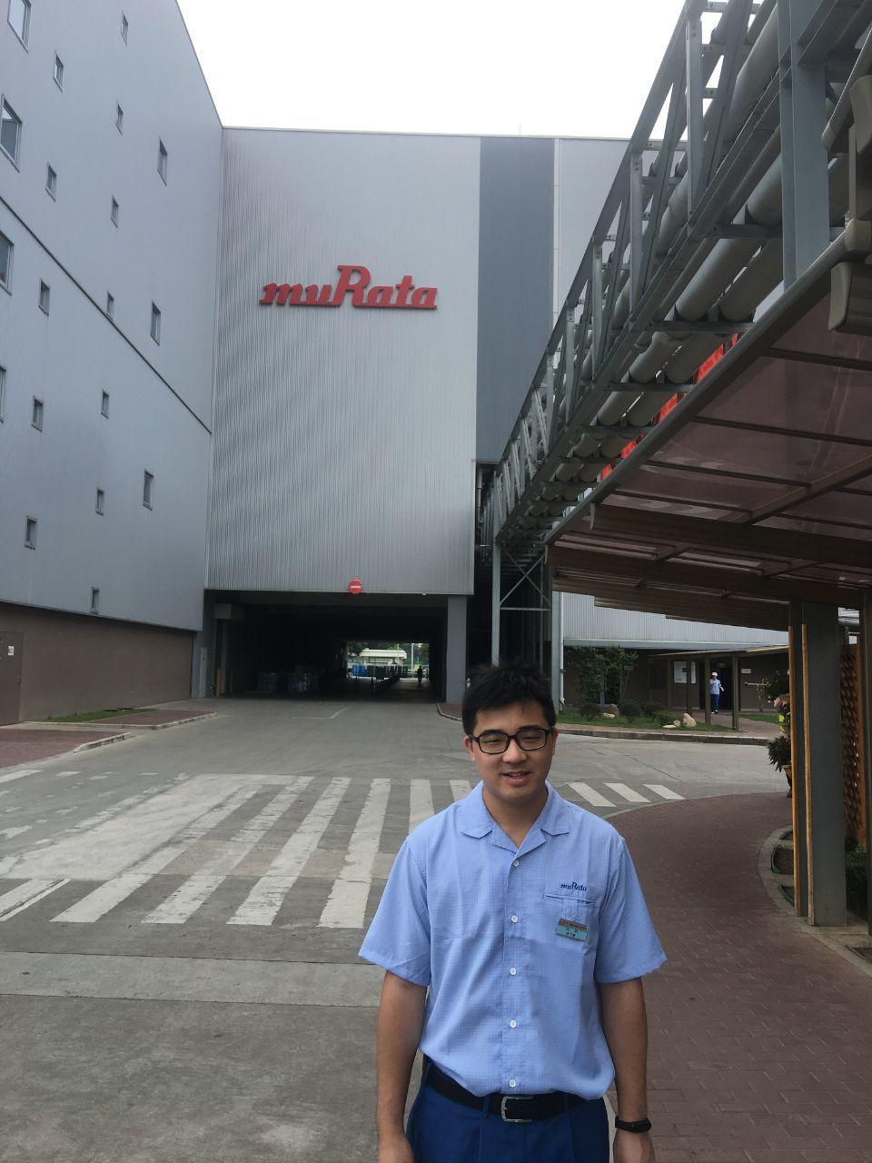

Take a Break Time on Internship

Slide 9
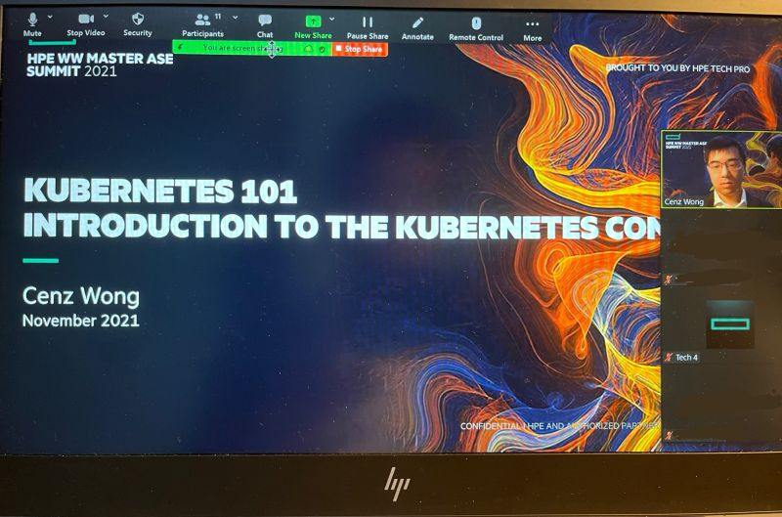
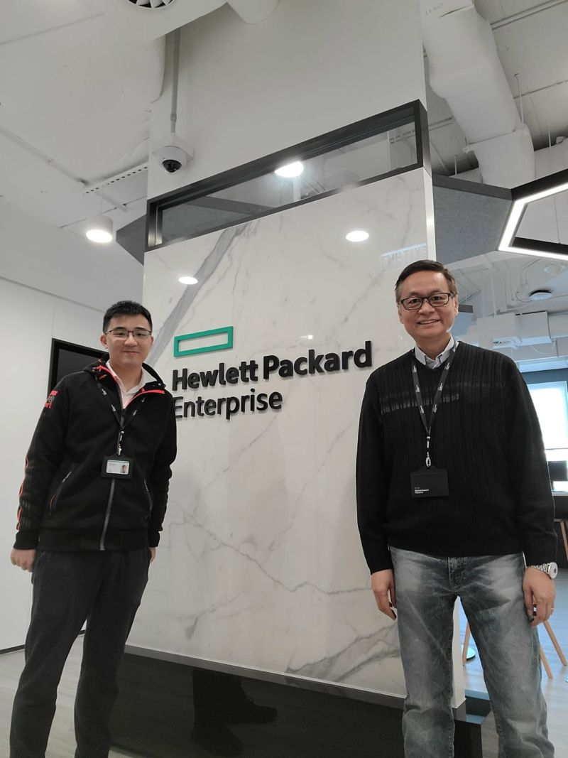

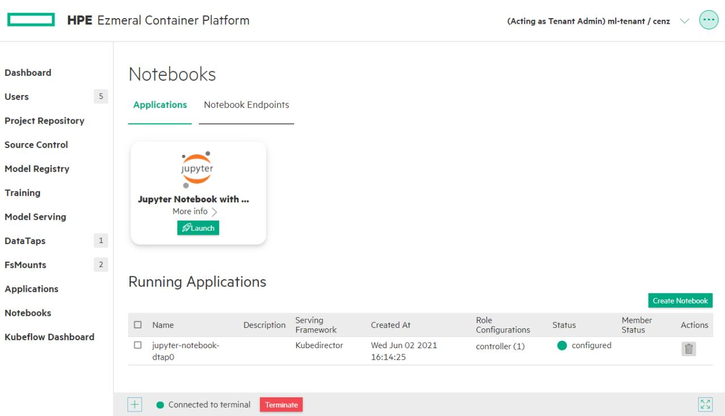
Kickstart my Career in HPE

Slide 10

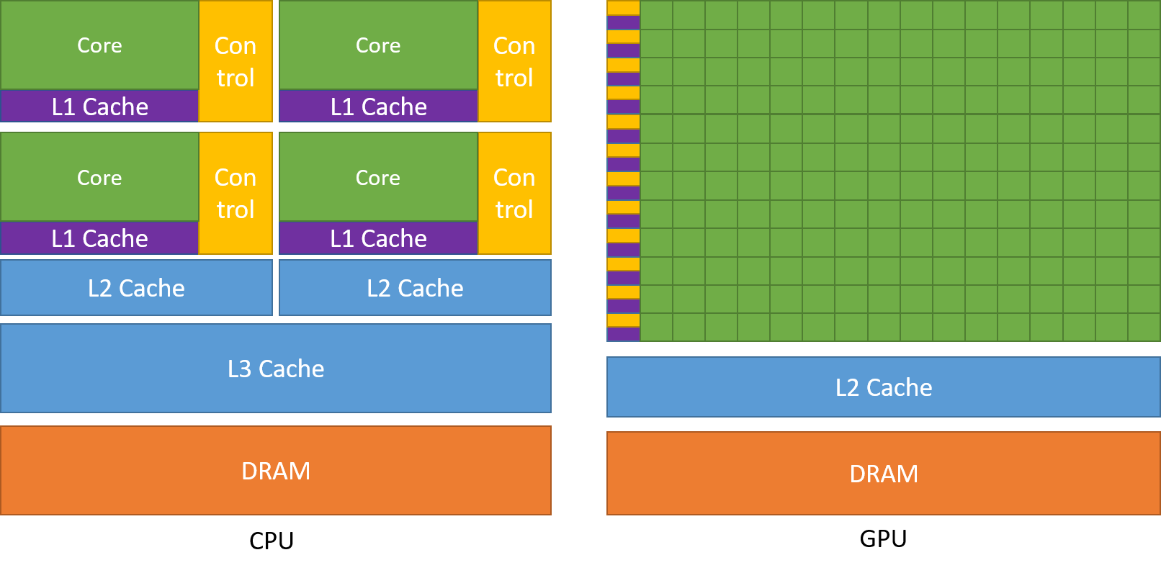
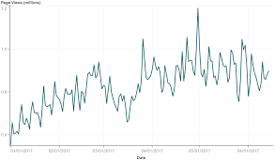
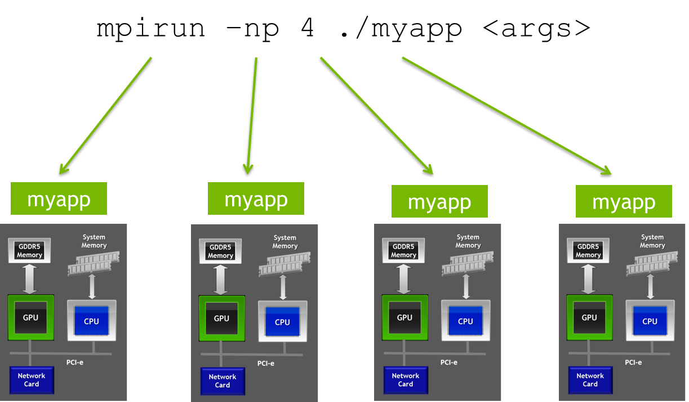
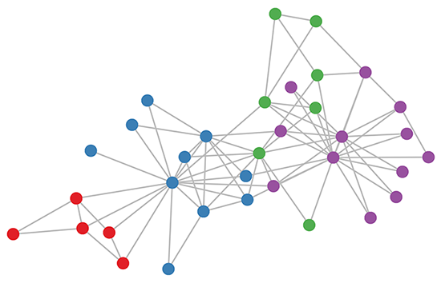
MSc BDT (2020-NOW)

Slide 11



What’s Next?
Eki.Cenz?

Slide 12




03.
My Life

Slide 13


Thank You
Cenz Wong

Slide 14

Cenz is a technology enthusiast who is interested in the data-related topics. He has an Electronic and Information Engineering background for IoT, Machine Learning knowledge and now he is pursuing a master's degree in big data technology. He has experiences on building IoT project as well as enterprise data platform.
Cenz WONG
Engineer Project Specialist I (HK Innovation Lab) - Hewlett Packard Enterprise
Provided technology consulting to external customers and internal project teams around HPE Ezmeral Portfolio (Container Platform, MLOps, Data Fabric), cloud-native analytics and data lakehouse platform by HPE.
Was responsible for providing technical support in the creation and delivery of technology solutions designed to meet customers’ business needs.
Built demo and Proof-of-Concept of Machine Learning Pipeline using Python, HPE Ezmeral, and other Open-Source Technologies. Maintain knowledge of leading-edge technologies on Big Data and Machine Learning and industry domain knowledge.
JC Data Engineer APAC
HKUST BDT - 2022
2 years of experience | English, Mandarin, Cantonese
Digital Transformation
Data Architecture
Data Visualization
Summer Intern (Business Engineer Department) - Wuxi Murata Electronics Co., Ltd.
Developed RPA (Robot Process Automation) sequence workflow with UI Path for HR system.
Electronic Engineer Trainee – ITE Smartcard Solutions Ltd.
Developed product of LoRa, NB-IoT and Product Development for Data Visualization Platform.
Firmware programming on IoT system of Self-service Library Station.
Streaming data analytics with IoT data
Python
Cloud
C/C++
Docker
Machine Learning
SQL

